Slide 1
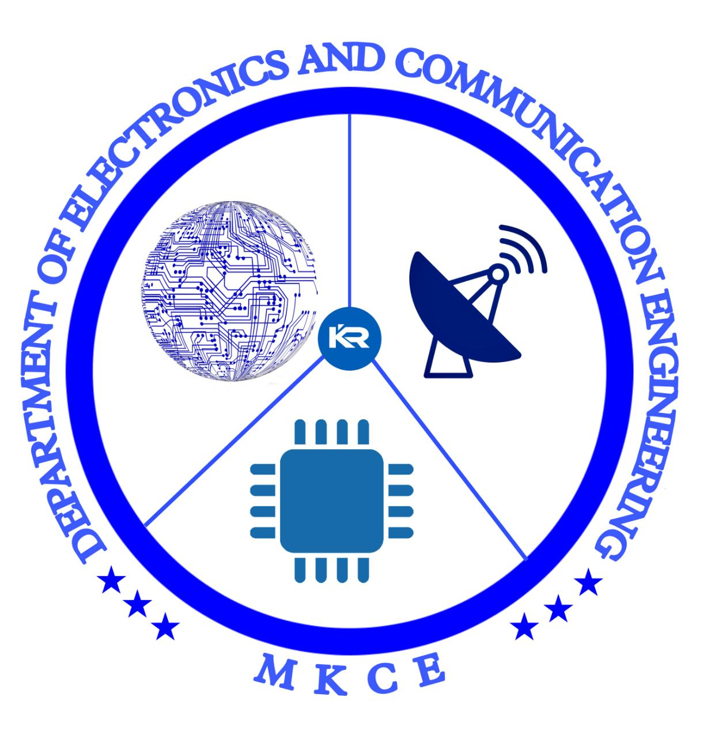


ANODYNE BLOOD GLUCOSE METER
GUIDED BY
Dr. S.VIMALNATH., ME.,Ph.D.,
Submitted By
MADHUSRI J 927621BEC109

Slide 2
INTRODUCTION
The Anodyne blood sugar glucose monitor represents a remarkable advancement in diabetes management.
By removing the need for finger pricking and offering pain-free, continuous monitoring, this technology empowers individuals with diabetes to take control of their health .

Slide 3
PROBLEM STATEMENT
The problem statement for blood sugar meters is that people with diabetes or other conditions that affect blood sugar levels need an accurate and reliable way to measure their blood glucose levels in order to manage their condition effectively.
To find the solution for measuring blood glucose without pricking of hand.
To find the connection protocols can be used in the product and offers the ability to access control

Slide 4
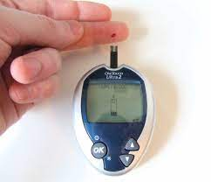
OBJECTIVES
The objective of a Anodyne glucose monitor without pricking of hand is to provide a painless and convenient way for people with diabetes to monitor their blood glucose levels.

Slide 5
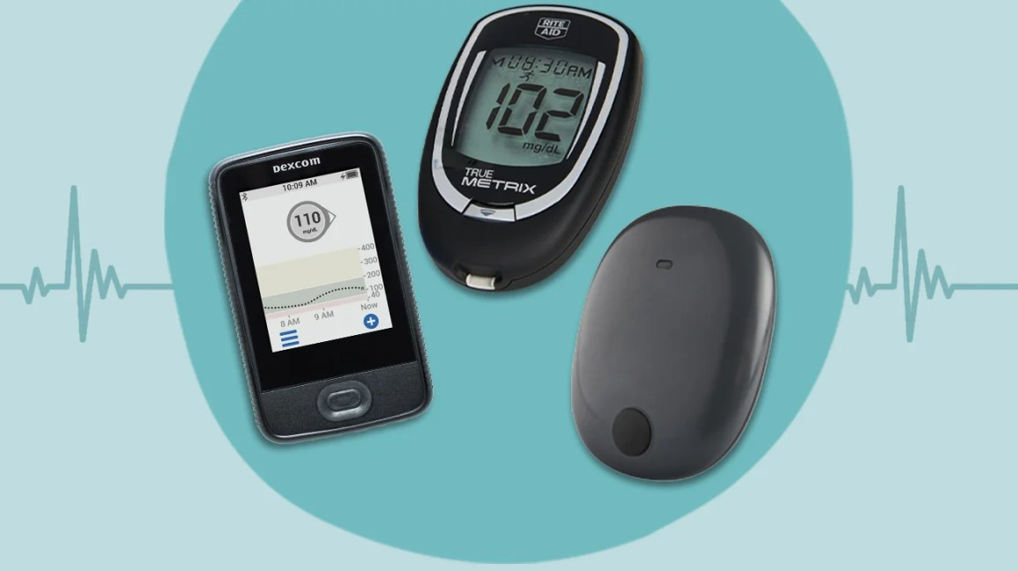
EXISTING SYSTEM
Blood Glucose Meters
Continuous Glucose Monitoring (CGM) Systems
Flash Glucose Monitoring
Insulin Pump Integration
Mobile Apps

Slide 6
PROPOSED SYSTEM
A proposed solution for Anodyne blood glucose monitoring is through breath analysis.
Breath Sampling: A person breathes into a specialized device or sensor that collects their breath sample.
VOC Analysis: The device analyzes the breath sample to detect specific VOCs that are indicative of glucose levels.
Data Interpretation: The collected data is processed and interpreted using algorithms to estimate the blood glucose level.

Slide 7
COMPARISON
Traditional blood glucose monitoring methods have long been a barrier to achieving optimal diabetes management.
Regular finger pricking can lead to discomfort, pain, and even anxiety for many individuals resulting in irregular monitoring.
The Anodyne blood sugar glucose monitor is to overcome these advanced technology to measure blood glucose levels without the need for needles or finger pricks.
Instead, we found a new method to find blood glucose with gas sensor by continuously and conveniently.

Slide 8
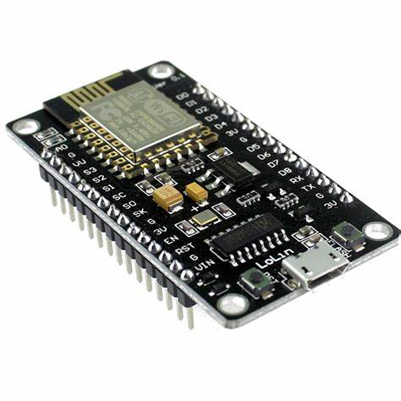
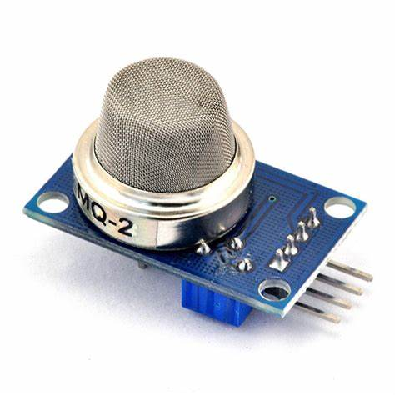
MODULES IDENTIFIED
HARDWARE
ARDUNIO ESP8266 MQ2 GAS SENSOR

Slide 9

SOFTWARE
ARDUINO :
It is used to code the ESP 8266 to transfer the data to Arduino IoT cloud.

Slide 10

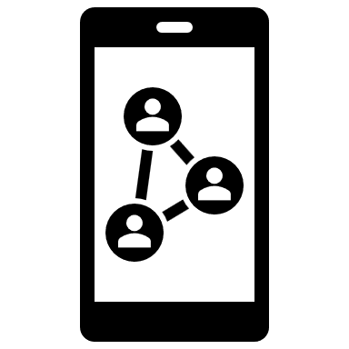
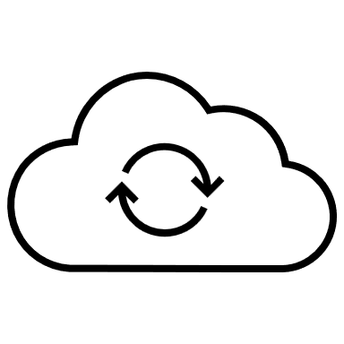

BLOCK DIAGRAM
GAS SENSOR
MQ 2
INPUT
(BLOWING)
IoT SERVER
IoT
SERVER
POWER SUPPLY
ARDUINO
ESP 8266
ARDUINO
IoT CLOUD

Slide 11
PLAN OF WORK COMPLETION
STEP 1: Without Pricking of hand to measure glucometer
STEP 2: Scopes for Diabetes Patient
STEP 3: Medical resources
STEP 4: We assigned each modules
STEP 5: Estimation of the project is Rs.450
STEP 6: Source_code is Done
STEP 7: Lag in interstitial fluid

Slide 12
CONCULSION
The project using Arduino that meet our objectives of the project with long range and increases the network lifetime.
It is an effective method to monitor blood glucose level which is made by wireless sensor networks using Arduino that meet our objectives of the project with long range, and increases the network lifetime.
However, Sensor networks are considered as the key enablers for the different application like glucose monitoring and controlling, hospitals etc.

Slide 13
REFERENCES
https://www.ncbi.nlm.nih.gov/pmc/articles/PMC7731259/#!po=6.78295
https://diabetestalk.net/blood-sugar/breath-glucose-meter

Slide 14


